Slide 1
Memory Hierarchy : Caches
CS 3339
Lecture 9 [zybook 5.1-5.4,5.14,5.15]
Apan Qasem
Texas State University
Spring 2024
*some slides adopted from P&H

Slide 2
Announcements
Quiz 8 out, due Friday, April 12 at midnight
HW3 due Friday, April 19 at midnight
All presentations on the last day of classes, April 25

Slide 3
Goals
Chapter 5
Understand how caches work and how we can make them more efficient
Understand data locality and how it affects cache performance

Slide 4
TL;DR
Memory Wall and Memory hierarchy
registers, L1, L2, L3, DRAM
Principle of Locality
temporal locality, spatial locality
Cache organization
placing and retrieving a data
Cache performance
hit rate, miss rate
Types of cache misses
capacity, compulsory, conflict misses
HW techniques for improving cache performance
cache blocks, set associativity

Slide 5
The Memory Wall
This gap has been driving architectural innovation for decades

Slide 6
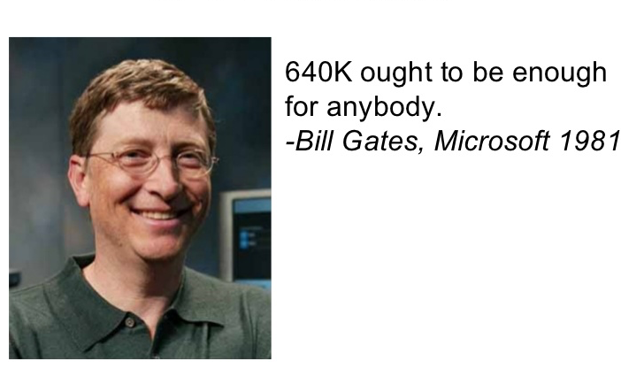
Dealing with the Memory Wall
Build faster memory
We are trying, but limited by technology
Current research in HBM
Can build fast memory that are small
Usually “small” is too small
acceptable size and speed do not coincide
Current solution
create a hierarchy of memory systems
progressively larger and slower

Slide 7

Caches : The basic idea
Register File
Cache
Processor
Memory
First check the cache;
go to main memory only if data is not found

Slide 8
A Typical Memory Hierarchy
Most systems today also have an L3 (aka LLC)
On-Chip Components
Control
(L1)
Datapath
Secondary
Memory
(Disk)
Instr
Cache
Main
Memory
(DRAM)
RegFile
Second
Level
Cache
(L2)
Data
Cache

Slide 9
Memory Hierarchy : Size and Speed
Beer analogy
On-Chip Components
Control
(L1)
Datapath
Secondary
Memory
(Disk)
Instr
Cache
Main
Memory
(DRAM)
RegFile
Second
Level
Cache
(L2)
Data
Cache
Speed (cycles): ½ 1’s 10’s 100’s 10,000’s
Size (bytes): 100’s 10K’s M’s G’s T’s
Cost per byte: highest lowest

Slide 10
Memory Hierarchy : Inclusiveness
On-Chip Components
Control
Instr
Cache
Secondary
Memory
(Disk)
Second
Level
Cache
(L2)
Main
Memory
(DRAM)
Datapath
RegFile
Data
Cache
The hierarchy is inclusive : what is in L1 is a subset of what is in L2 is a subset of what is in MM is a subset of what is on disk

Slide 11
Cache Performance: Example
Assume system A and B both have a single core 3 GHz processor.
System A has 16 KB L1 and a 1 MB L2
System B has a 32 KB L1 and a 2 MB L2
What is the expected speedup on System B for a given program X?
Don’t know!

Slide 12
No!
Need Data Locality

Slide 13

Data Locality : Example
...
...
string name = “”;
int age = 0;
cout << “Enter name: ” << endl;
cin >> name;
cout << “Enter age: ” << endl;
cin >> age;
...
if (age > 60)
cout << name << “ “ << age << endl;
...

Slide 14
Temporal Locality
S
memory
program
scale = 3.14;
for (int i = 0; i < N; i++)
a[i] = b[i] + scale;
more locality if same value is accessed many times
more locality if many values are accessed a few times

Slide 15
Spatial Locality
a₀
a₁
a₂
a₃
memory
program
scale = 3.14;
for (int i = 0; i < N; i++)
a[i] = b[i] + scale;
more locality if accessing many nearby values

Slide 16
Types of Locality
Temporal Locality (locality in time)
If a program accesses memory location M, it is likely that it will access M again in the near future
⇒ Keep most recently accessed data items closer to the processor
Spatial Locality (locality in space)
If a program accesses memory location M, it is likely that it will access M + k in the near future
⇒ Move blocks consisting of contiguous words closer to the processor

Slide 17
Review
Memory Layout
Binary Representation
Binary Math

Slide 18
Memory Layout
address
Simplified view :
all data stored in array or table
0000001
0000010
0000011
0000100
…
…
…
…
…
00000001000011
00000001001100
00000000000000
00000000000000
00000001000011
00000001001100
00000000000000
00000000000000
instructions
The address itself is not stored
For 2³² bytes of memory need 32-bit address
data
memory

Slide 19
Power-of-two rule
What is the range of values that we can represent using k bits?
How many bits do we need to represent a value N?
2^{k}
(permutations with repetitions;
choosing one of 2 items, k times)
For 3 bits
000 001 010 011 100 101 110 111

Slide 20
Binary Math : mult and div by powers-of-two
Multiplication by 2
6 x 2 = 12
0110 x 10 = 01100 // tack a zero at the right-end
Multiplication by 2^{n}
6 x 8 = 48
0110 x 1000 = 0110000 // tack n zeros at the right-end
Division by 2
37 / 2 = 18
100101 / 10 = 10010 // chop off least significant bit
Division by 2^{n}
37 / 8 = 4
100101 / 1000 = 100 // chop off n least significant bits
just like multiplication and division by 10 is easy base 10

Slide 21
Binary Math : mod by powers-of-two
Mod by 2
37 % 2 = 1
100101 % 10 = 1 // extract least significant bit
Mod by 2^{n}
37 % 8 = 101
100101 % 1000 = 101 // extract least significant n bits

Slide 22
Back to Caches

Slide 23
Cache Organization
memory address
data
Data
copy of memory data
each entry/block is a word (for now)
Metadata
Tag
used to uniquely identify a memory location
Valid bit
indicates whether data is valid
Index/Address
location of data in cache
uniquely identifies each cache block
not stored in cache
0010001
00000001000011
Valid
bit
Index
Tag
Data
0
1
2
3
4
5
6
7
8
9
10
11
00000001000011
need a function that can map a memory address
to a cache index

Slide 24
Cache Indexing
# of blocks in memory > # of blocks in cache
Simplest scheme is to use modulo-based placement
Modulo 4
mem block 0, 4, 8, 12, 16 … map to cache block 0
mem block 1, 5, 9, 13, 17 … map to cache block 1
index = (mem address) mod (# of blocks in cache)
This type of mapping is called direct mapping
Hash Tables?

Slide 25
Direct Mapping
Main Memory
Cache
0000
0001
0010
0011
0100
0101
0110
0111
1000
1001
1010
1011
1100
1101
1110
1111
Index
Valid
Tag
Data
00
01
10
11
Notes:
For class handout

Slide 26
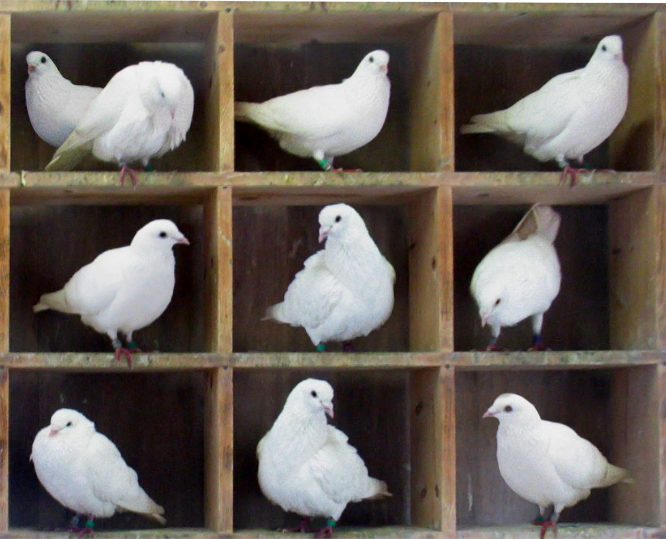
The Problem with Modulo Mapping
There are more memory blocks than cache blocks (that’s the whole idea)
More than one memory block can map to the same cache block (how do we know this?)
Don’t know if the data stored in the index location is the one we are looking for

Slide 27
The Problem with Modulo Mapping
Need a mechanism to uniquely identify each block
Solution: store a tag with the data

Slide 28
Calculating the Tag
Main Memory
Cache
0000
0001
0010
0011
0100
0101
0110
0111
1000
1001
1010
1011
1100
1101
1110
1111
What could serve as a tag in this example?
Index
Valid
Tag
Data
00
01
10
11
The high-order two bits
11
Notes:
For class handout

Slide 29
The Tag
Use high-order n bits in the address as the tag
the right digit gives us the index
these addresses all map to slot 5
05, 15, 25, 35, 45, 55
the left digit uniquely identifies data location in memory
base-10, modulo 10

Slide 30
Retrieving Data from Cache
The problem
Given a memory address of a word, locate it in cache
Steps
Find index
Match Tag

Slide 31
Retrieving Data from Cache
Step 1 : Find index
To determine the index, we need to mod the memory address with the number of blocks in cache
Modding a binary value by 2^{m} is simply a matter of extracting the low-order m bits
00111000 => mod by 4 => LSF 2 bits => 00
11111111 => mod by 8 => LSF 3 bits => 111
How big should m be if our cache holds 1024 blocks?
need a 10-bit index [ log(1024) = 10; 2¹⁰ = 1024 ]

Slide 32
Retrieving Data from Cache
Step 2 : Match tag
Don’t know if the particular word we are looking for is at the index location because more than one block can map to the same index location
Use high-order n bits in address to check if it matches the tag stored with the data
Example
00111000 => extract MSF 6 bits => 001110
11111111 => extract MSF 5 bits => 11111
Use a bit mask: OR
Could we have used a scheme that uses a
32-bit tag?

Slide 33
Retrieving Data in a Direct-Mapped Cache
Main Memory
0000
0001
0010
0011
0100
0101
0110
0111
1000
1001
1010
1011
1100
1101
1110
1111
Cache
Index
Valid
Tag
Data
00
01
1
01
10
11
How do we find it?
2 low-order memory address bits to determine which cache block (i.e., modulo the number of blocks in the cache)
Do we have the right value?
Compare the cache tag to the high order 2 memory address bits to tell if the memory block is in the cache

Slide 34
Word vs Byte Address (and offsets)
integer index
0
1
2
3
4
5
6
7
8
9
10
11
data
byte address
000000
000001
000010
000011
000100
000101
000110
000111
001000
001001
001010
001011
word address
000000
000001
000010
000011
000100
000101
000110
00111
001000
001001
001010
001011
word offset
000000
000001
000010
000011
000100
000101
000110
00111
001000
001001
001010
001011

Slide 35
Memory Address and Mailing Address
block
offset
word offset
tag
index
memory
address
0 1 1 0 0 1 1 0 0 0 0 1 1 0 1 0 1 1 0 1
1 0 0 0 1 1 1
1 0
1 1
street
address
Texas
Austin
54 Rainey Street
Unit 318
Kentucky
Austin
54 Rainey Street
Unit 318
high-order bits uniquely distinguishes address

Slide 36
Direct Mapping with Word Address
Main Memory
Cache
0000xx
0001xx
0010xx
0011xx
0100xx
0101xx
0110xx
0111xx
1000xx
1001xx
1010xx
1011xx
1100xx
1101xx
1110xx
1111xx
One-word blocks
Two low-order bits define the byte in the word (32-bit words)
Index
Valid
Tag
Data
00
01
1
01
10
11
How do we find it?
Use next 2 low-order memory address bits to determine which cache block (i.e., modulo the number of blocks in the cache)
Do we have the right value?
Compare the cache tag to the high order 2 memory address bits to tell if the memory block is in the cache

Slide 37
Retrieving Data from Cache with Word Address
Word offset
31 30 . . . 13 12 11 . . . 2 1 0
Hit
Tag
20
10
Data
Index
Index
Valid
Tag
Data
0
1
2
.
.
.
1021
1022
1023
20
32

Slide 38
Improving Cache Performance

Slide 39
Cache Hits and Misses
When the value we are looking for is found in the cache, it is called a cache hit
On a cache hit the data is delivered to the next higher-level memory
When the value is not found in the cache, it is a cache miss
On a cache miss data is brought in from the next lower level into the current level and then delivered to the next higher-level memory
Found bottle in cooler; bottle transferred from cooler to hand
Didn’t find bottle in cooler; go to fridge and refill cooler; transfer bottle from cooler to hand

Slide 40
Cache Performance Metrics
Hit Rate the fraction of memory accesses found in cache during program execution
Hits to Access ratio
Can be generalized to any level of the memory hierarchy
Hit Time time to access value from cache
time to access the block + time to determine hit/miss
Goal is to increase hit rate or reduce miss rate

Slide 41
Cache Performance Metrics
Miss Rate the fraction of memory accesses not found in a level of the memory hierarchy ⇒ 1 - (Hit Rate)
Need to be careful about relating this to overall performance
A 1% miss rate is considered very high!
Miss Penalty time to replace a block in cache with the corresponding block from a lower level which consists of
time to access the block in the lower level
+ time to transmit that block to the level that experienced the miss
+ time to insert the block in that level
+ time to pass the block to the requestor

Slide 42
Types of Cache Misses
The three C’s
Compulsory or “cold” Misses
Capacity Misses
Conflict Misses

Slide 43
Compulsory Misses
Initially, all data and instructions for a program are in main memory
First access to any memory location is always a miss
Bad news : Not a whole lot we can do about it
Good news : For programs with millions of dynamic instructions, compulsory misses often become insignificant
Need to go to the fridge to fill up the cooler for the first time

Slide 44
Capacity Misses
If the amount of data accessed between two references to the same memory location M is greater than the cache capacity then the second reference to M is going to be a miss. This type of miss is considered a capacity miss
Most cache misses are capacity misses
Cooler holds 12 beers;
You have 5 friends. Each will drink 3 beers
Assuming, your alcoholic friend Chad consumes beer at a faster rate, their request for the third beer will not be satisfied by the cooler.
They will need to go to the fridge

Slide 45
Conflict Misses
Conflict misses occur when
Two memory locations M and M’ map to the same cache block
M’ evicts M before the second reference to M
No conflict miss if M is not reused
Cooler has designated slots for beer and wine
Your friend drinks Porter and you prefer IPAs;
Friend fills up beer slots with Porters
Room in the cooler but no IPA for you;
You fill up beer slots with IPAs
Room in the cooler but no Porter for your friend

Slide 46
Memory References in One-word Blocks
Consider the main memory word reference string 0 1 2 3 4 3 4 15
In binary, mem address 2 = 0010 , 4 = 0100 and 15 = 1111
tag
0
miss
1
miss
2
miss
3
miss
00
01
10
11
00 Mem[0]
00 Mem[0]
00 Mem[0]
00 Mem[1]
00 Mem[0]
00 Mem[1]
00 Mem[2]
00 Mem[1]
00 Mem[2]
00 Mem[3]
4
miss
3
hit
4
hit
15
miss
00
01
10
11
01
4
00 Mem[0]
00 Mem[1]
00 Mem[2]
00 Mem[3]
01 Mem[4]
00 Mem[1]
00 Mem[2]
00 Mem[3]
01 Mem[4]
00 Mem[1]
00 Mem[2]
00 Mem[3]
01 Mem[4]
00 Mem[1]
00 Mem[2]
00 Mem[3]
11
15
8 requests, 6 misses

Slide 47
Improving Cache Performance I : Cache Blocks
We can exploit spatial locality by storing data in cache blocks
A block of size k stores, k consecutive words in memory
When bringing in memory word M into cache, bring in the next few words as well, because we are likely to need them soon
When making a trip to the fridge fill up the cooler; don’t just put one beer in it

Slide 48
Taking Advantage of Spatial Locality
consider the main memory word reference string 0 1 2 3 4 3 4 15
let cache block hold two words (block offset = 1 bit)
In binary, mem address 2 = 0010 , 4 = 0100 and 15 = 1111
0 = 0000
1 = 0001
2 = 0010
3 = 0011
4 = 0100
5 = 0101
14 = 1110
15 = 1111
0
miss
1
hit
2
miss
0
1
00 Mem(1) Mem(0)
00 Mem(1) Mem(0)
00 Mem(1) Mem(0)
Start with an empty cache - all blocks initially marked as not valid
00 Mem(3) Mem(2)
3
hit
4
miss
3
hit
01
5
4
0
1
00 Mem(1) Mem(0)
00 Mem(1) Mem(0)
01 Mem(5) Mem(4)
00 Mem(3) Mem(2)
00 Mem(3) Mem(2)
00 Mem(3) Mem(2)
4
hit
15
miss
8 requests,
4 misses
0
1
01 Mem(5) Mem(4)
11
01 Mem(5) Mem(4)
15
14
00 Mem(3) Mem(2)
00 Mem(3) Mem(2)

Slide 49
Cache Organization with Blocks
4 words / block
Valid
bit
Index
Tag
Data
mem addr = M + 8
mem addr = M
mem addr = M + 4
mem addr = M + 12
0
1
2
3
4
5
6
7
8
9
10
11
word 0
word 1
word 2
word 3
cache stores and transfers data from memory in blocks
typical block size is 8-16 words (32-64 bytes)

Slide 50
Retrieving Data from Cache (w/ blocks)
The problem
Given a memory address of a word, locate it in cache
Steps
Find index
Match Tag
Find correct word

Slide 51
Retrieving Data from Cache (w/ blocks)
Step 3 : Find the correct word
Extract block offset from address
Bits 2-3 for a cache with 4 words per block
Read all words through a mux
Use block offset to control mux

Slide 52
Retrieving Data from Cache (w/ blocks)
word offset
(ignored)
Hit
31 30 . . . 13 12 11 . . . 5 4 3 2 1 0
Data
Tag
18
10
block offset
Index
Index
Valid
Tag
Data
0
1
2
.
.
.
1021
1022
1023
18
MU X
32

Slide 53
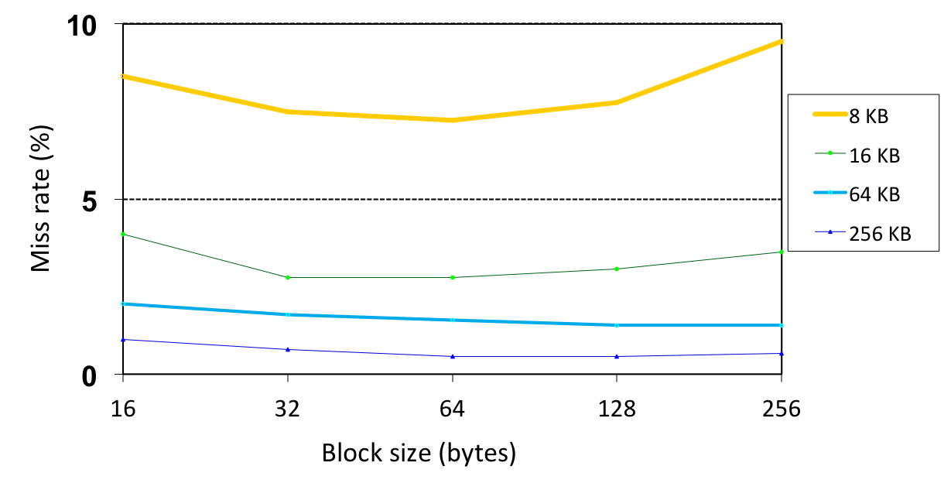
Miss Rate vs Block Size vs Cache Size
Typical block size on modern systems is 8-16 words. Why not make it larger?
Making block sizes larger implies giving up capacity – unless all memory
references exhibit spatial locality

Slide 54
Memory References in Direct-mapped Cache
Consider the main memory references to 0 4 0 4 0 4 0 4
In binary, address 0 = 0000 and 4 = 0100
0
miss
4
miss
0
miss
4
miss
01
4
00
0
01
4
00
01
10
11
00 Mem(0)
00 Mem(0)
01 Mem(4)
00 Mem(0)
0
miss
01
4
miss
00
0
miss
01
4
miss
00
0
4
0
4
00
01
10
11
01 Mem(4)
00 Mem(0)
01 Mem(4)
00 Mem(0)
Ping pong effect due to conflict misses - two memory locations that map to the same cache block
8 requests, 8 misses

Slide 55
Improving Cache Performance II : Set Associativity
Allow more flexible block placement
In a direct-mapped cache a memory block maps to exactly one cache block
At the other extreme, could allow a memory block to be mapped to any cache block – fully associative cache
How many conflicts would we see in such a cache?
A compromise is to divide the cache into sets, each of which consists of n “ways” (n-way set associative). A memory block maps to a unique set (specified by the index field) and can be placed in any way of that set (so there are n choices)
index = (mem address) mod (# sets in the cache)

Slide 56
Example: Set Associative Cache
Main Memory
0000xx
0001xx
0010xx
0011xx
0100xx
0101xx
0110xx
0111xx
1000xx
1001xx
1010xx
1011xx
1100xx
1101xx
1110xx
1111xx
Cache
Way
Set
V
Tag
Data
One-word blocks
Two low-order bits define the byte in the word (32b words)
0
0
1
0
1
1

Slide 57
Example: Set Associative Cache
Main Memory
0000xx
0001xx
0010xx
0011xx
0100xx
0101xx
0110xx
0111xx
1000xx
1001xx
1010xx
1011xx
1100xx
1101xx
1110xx
1111xx
Cache
One-word blocks
Two low order bits define the byte in the word (32-bit words)
Way
Set
V
Tag
Data
0
0
001
1
0
011
1
1
How do we find it?
Use next 1 low-order memory address bit to determine which cache set (i.e., modulo the number of sets in the cache)
Do we have right block?
Compare all cache tags in the set to the high order 3 memory address bits to tell if the memory block is in the cache

Slide 58
Example : Set-Associative Cache
Consider the main memory word reference string 0 4 0 4 0 4 0 4
In binary, address 0 = 0000 and 4 = 0100
0
miss
4
miss
0
hit
4
hit
00
01
00
01
00 Mem(0)
00 Mem(0)
00 Mem(0)
00 Mem(0)
01 Mem(4)
01 Mem(4)
01 Mem(4)
solves cache thrashing in direct mapped caches
two memory locations that map into the same cache set can now co-exist
8 requests, 2 misses

Slide 59
Four-Way Set Associative Cache
31 30 . . . 13 12 11 . . . 2 1 0
Word offset
Tag
22
8
2⁸ sets, each with four ways
Index
Index
V
Tag
Data
V
Tag
Data
V
Tag
Data
V
Tag
Data
0
1
2
.
.
.
253
254
255
0
1
2
.
.
.
253
254
255
0
1
2
.
.
.
253
254
255
0
1
2
.
.
.
253
254
255
Way 0
Way 1
Way 2
Way 3
32
MU X
Note, still need to find the correct word in a block
Hit
Data

Slide 60
Replacement Policy For Set Associative Caches
For set-associative caches need to decide which block to replace or evict when a miss occurs
Least Recently Used (LRU)
the block replaced is the one that has been unused for the longest time
must have hardware to keep track of when each way’s block was used relative to the other blocks in the set
for 2-way set associative
need one bit per set
set the bit when a block is referenced (and reset the other way’s bit)
Are there other policies we could try?

Slide 61
Costs of Set Associative Caches
N-way set associative cache costs
N comparators (delay and area)
MUX delay (set selection) before data is available

Slide 62
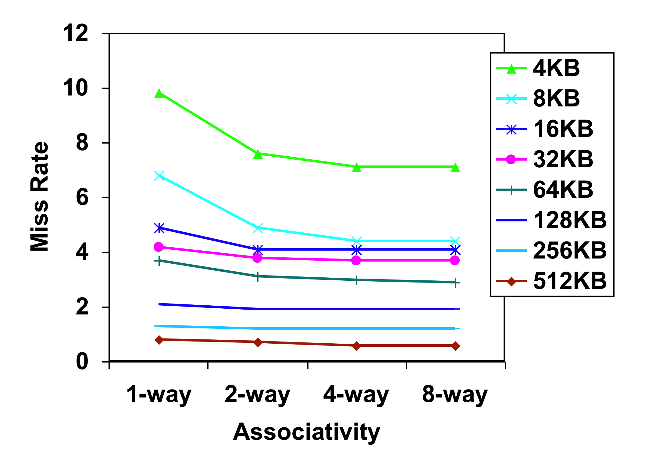
Benefits of Set Associative Caches
The choice of direct-mapped or set associative depends on the cost of a miss versus the cost of implementation
Data is old but still holds
Data from Hennessy & Patterson, Computer Architecture, 2003
Largest gains are in going from direct mapped to 2-way
(20%+ reduction in miss rate)

Slide 63
Addressing in Set Associative Caches
For a fixed size cache, each increase by a factor of two in associativity halves the number of sets
Decreases the size of the index by 1 bit and increases the size of the tag by 1 bit
Used for tag compare
Selects the set
Selects the word in the block
Tag
Index
Block offset
Word offset
Increasing associativity
Decreasing associativity
Fully associative
(only one set)
Tag is all the bits except
block and byte offset
Direct mapped
(only one way)
Smaller tags, only a single comparator

Slide 64
Improving Cache Performance III : Multiple-levels
Use multiple levels of caches
With advancing technology, we have more than enough room on the die for bigger L1 caches or for a second level of caches
normally a unified L2 cache (i.e., it holds both instructions and data) and in some cases even a unified L3 cache

Slide 65
Cache Write Policies
To keep the memory hierarchy consistent, when we write a data value to the L1 cache, we also write it to L2, and main memory
This implies a main memory access for every store whether it’s a hit or miss!
To avoid this long latency for stores, two types of write policies are used
Write-through
when writing to a particular level, write value to all lower levels as well
expensive but don’t need to worry about maintaining consistency
Write-back
write data only to the current level cache
mark as modified or dirty
write to lower level only when evicted

Slide 66
Improving Cache Performance: Summary
Reducing compulsory misses
increase block size
use prefetching at the SW and HW levels
Reducing capacity misses
increase cache size
compiler optimizations
reorder/schedule instructions in a way so that we don’t access a lot of data between reuse
Reducing conflict misses
increase associativity
increase cache size
use better replacement policy
Fetch beer from the fridge
when you start on the last one

Slide 67
Improving Cache Performance: Summary
Reduce the time to hit in the cache
smaller cache
direct mapped cache
smaller blocks
Reduce the miss rate
bigger cache
more flexible placement (increase associativity)
larger blocks (16 to 64 bytes typical)
victim cache – small buffer holding most recently discarded blocks

Slide 68
Improving Cache Performance: Summary
Reduce the miss penalty
smaller blocks
use a write buffer to hold dirty blocks being replaced so don’t have to wait for the write to complete before reading
check write buffer (and/or victim cache) on read miss – may get lucky
for large blocks fetch critical word first
use multiple cache levels – L2 cache not tied to CPU clock rate
faster backing store/improved memory bandwidth
wider buses
memory interleaving, DDR SDRAMs

Slide 69
The Cache Design Space
Several interacting dimensions
cache size
block size
associativity
replacement policy
write-through vs write-back
write allocation
The optimal choice is a compromise
depends on access characteristics
workload
use (I-cache, D-cache, TLB)
depends on technology / cost
Simplicity often wins
Cache Size
Associativity
Block Size
Bad
Good
Factor A
Factor B
Less
More

Slide 70
“Advanced” Topics

Slide 71
Memory Wall in the multicore era: Number of Cores vs. Bandwidth
Future
Trend continues with multicore systems:
bandwidth limitations

Slide 72
Compiler optimization for the cache: Loop Interchange
DO I = 1, N
DO J = 1, M
A(I,J) = A(I,J) + B(J)
ENDDO
ENDDO
What kind of locality do we have here?

Slide 73
Multi-Dimensional Array Layout
A[20]
0
19
A[5][4]
0
3
row major
consecutive elements in a row are consecutive in
memory
column major
consecutive elements in a column are consecutive in
memory
0
4

Slide 74
Loop Interchange : Example
row number
column number
DO I = 1, N
DO J = 1, M
A(I,J) = A(I,J) + B(J)
ENDDO
ENDDO
FORTRAN is column-major
Exploit spatial locality for references to A
Loops interchanged
Register reuse for reference to B
DO J = 1, M
DO I = 1, N
A(I,J) = A(I,J) + B(J)
ENDDO
ENDDO
Profitability depends on how arrays are laid-out in memory

Slide 75
Handling Cache Misses
Read misses
stall the pipeline
fetch the block from the next level in the memory hierarchy
place data value in appropriate slot in current-level cache
find suitable data value to evict if needed
send the requested word to the processor
let the pipeline resume
Non-blocking cache
allows the processor to continue to access the cache while the cache is handling an earlier miss
tricky

Slide 76
Handling Cache Misses
Write misses
stall the pipeline
fetch the block from next level in the memory hierarchy
place data value in appropriate slot in current-level cache
If write-through
write block in current-level cache and all lower levels
If write-back
write block in current-level cache
If a dirty block is evicted, write that block to a lower-level cache
let the pipeline resume
Store buffers
HW used to buffer store requests and handle them in the background

Slide 77
Intel-AMD Cache Comparison
 | Intel Nehalem | AMD Barcelona
L1 cache organization & size | Split I$ and D$; 32KB for each per core; 64B blocks | Split I$ and D$; 64KB for each per core; 64B blocks
L1 associativity | 4-way (I), 8-way (D) set assoc.; ~LRU replacement | 2-way set assoc.; LRU replacement
L1 write policy | write-back, write-allocate | write-back, write-allocate
L2 cache organization & size | Unified; 256KB per core; 64B blocks | Unified; 512KB per core; 64B blocks
L2 associativity | 8-way set assoc.; ~LRU | 16-way set assoc.; ~LRU
L2 write policy | write-back | write-back
L3 cache organization & size | Unified; 8192KB (8MB) shared by cores; 64B blocks | Unified; 2048KB (2MB) shared by cores; 64B blocks
L3 associativity | 16-way set assoc. | 32-way set assoc.; evict block shared by fewest cores
L3 write policy | write-back, write-allocate | write-back; write-allocate

Slide 78
Intel-AMD Cache Comparison
 | Intel P4 | AMD Opteron
L1 organization | Split I$ and D$ | Split I$ and D$
L1 cache size | 8KB for D$, 96KB for trace cache (~I$) | 64KB for each of I$ and D$
L1 block size | 64 bytes | 64 bytes
L1 associativity | 4-way set assoc. | 2-way set assoc.
L1 replacement | ~ LRU | LRU
L1 write policy | write-through | write-back
L2 organization | Unified | Unified
L2 cache size | 512KB | 1024KB (1MB)
L2 block size | 128 bytes | 64 bytes
L2 associativity | 8-way set assoc. | 16-way set assoc.
L2 replacement | ~LRU | ~LRU
L2 write policy | write-back | write-back

Slide 79
Memory Hierarchy : Responsibilities
registers ↔ cache : compiler
cache ↔ main memory : compiler, cache controller
main memory ↔ disks : OS, TLB, programmer
On-Chip Components
Control
(L1)
Datapath
Secondary
Memory
(Disk)
Instr
Cache
Main
Memory
(DRAM)
RegFile
Second
Level
Cache
(L2)
Data
Cache

Slide 80
Memory Technologies
Caches use SRAM for speed and technology compatibility
Fast (typical access times of 0.5 to 2.5 nsec)
Low density (6 transistor cells), higher power, expensive ($2000 to $5000 per GB in 2008)
Static: content will last forever (as long as power is left on)
Main memory uses DRAM for size (density)
Slower (typical access times of 50 to 70 nsec)
High density (1 transistor cells), lower power, cheaper ($20 to $75 per GB in 2008)
Dynamic: needs to be refreshed regularly (~ every 8 ms)
consumes 1% to 2% of the active cycles of the DRAM
Notes:
Size comparison: DRAM/SRAM is 4 to 8 times
Cost/cycle time comparison SRAM/DRAM is 8 to 16 times

